Slide 1
Authentication and Access Control
Information Security

Slide 2
Identification and Authentication
Token-Based Authentication
A token is a highly secure format used to transmit sensitive information between two parties
Token-based authentication is different from traditional password-based or server-based authentication techniques.
Tokens offer a second layer of security, and administrators have detailed control over each action and transaction.
Tokens add security because:
They act as temporary keys — only valid for a short time or one session.
They can be given limited permissions — for example, a token can allow only “read” or “write” access.
Admins can track and revoke them — if something looks wrong, the token can be disabled instantly.

Slide 3
Identification and Authentication
Token-Based Authentication
Token-based authentication is a web authentication protocol that allows users to verify their identity a single time and receive a uniquely-generated encrypted token in exchange.
Most importantly, tokens are machine-generated. Encrypted, machine-generated code is significantly more secure than any password you might create yourself.
Notes:
OAuth 2.0
Within the OAuth 2.0 paradigm, there are two token types: Access and Refresh Tokens. Access Tokens grant access to a protected resource. \
Swoop is a simple & secure password-free authentication service.

Slide 4
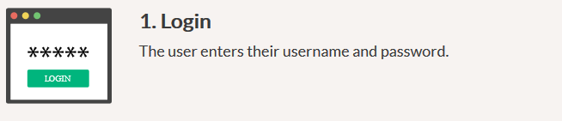
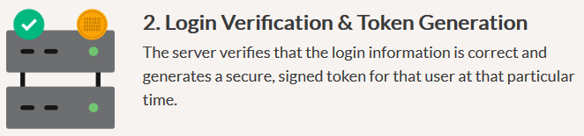

Identification and Authentication
Token-Based Authentication: Steps

Slide 5
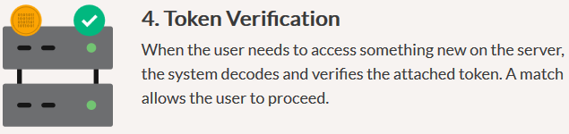

Identification and Authentication
Token-Based Authentication: Steps

Slide 6
Identification and Authentication
Biometric authentication
Each person has a set of unique characteristics that can be used for authentication. Biometrics uses these unique characteristics for authentication.
Today’s Biometric systems examine retina patterns, iris patterns, fingerprints, handprints, voice patterns, for authentication.
Biometric identification systems normally work by obtaining unique characteristics from you, like a fingerprints, a retina pattern etc.
The biometric system then compares that to the specimen data stored in the system.

Slide 7
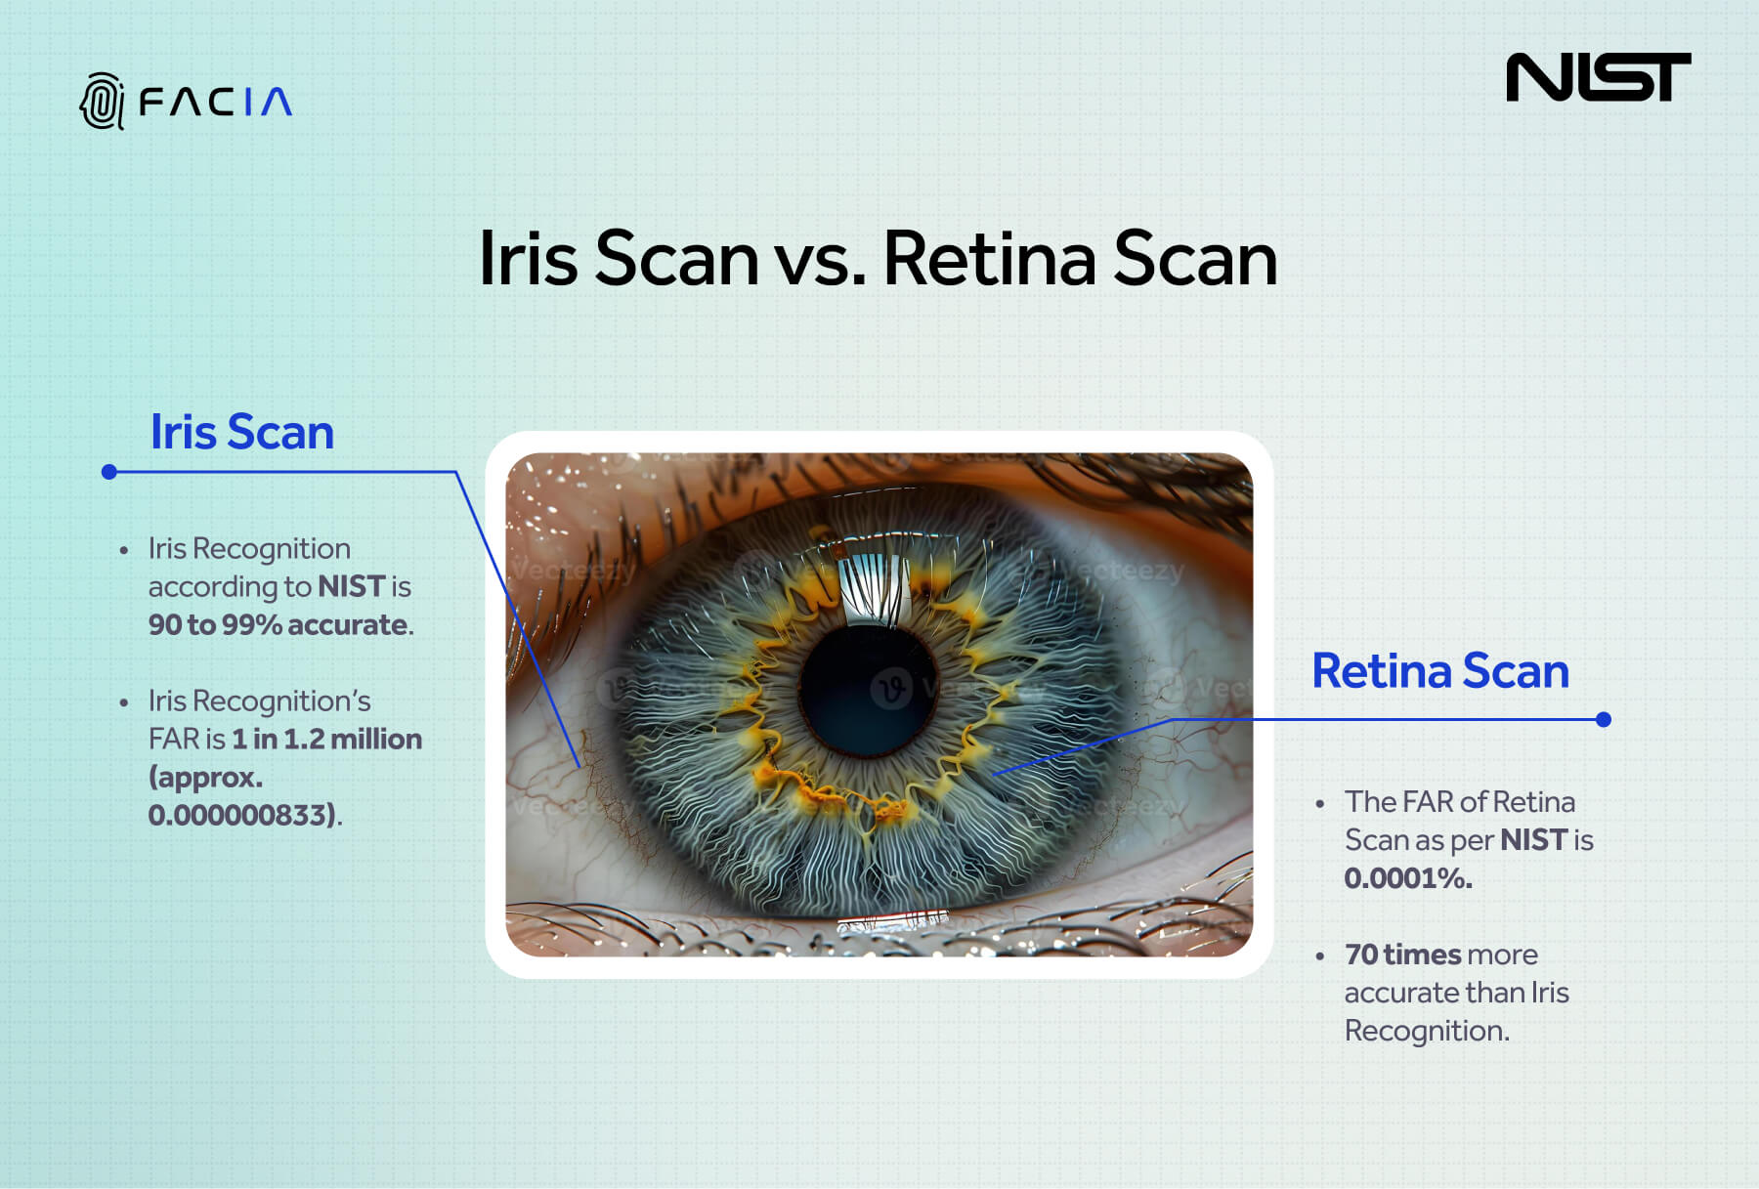

Slide 8
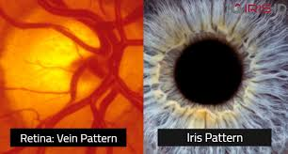

Slide 9
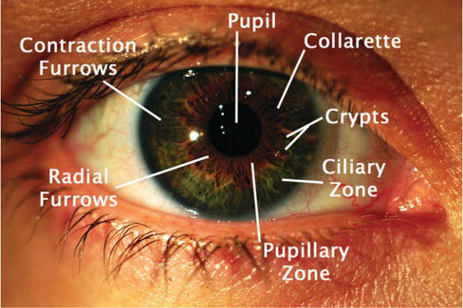

Slide 10
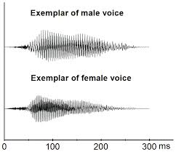

Slide 11


Slide 12
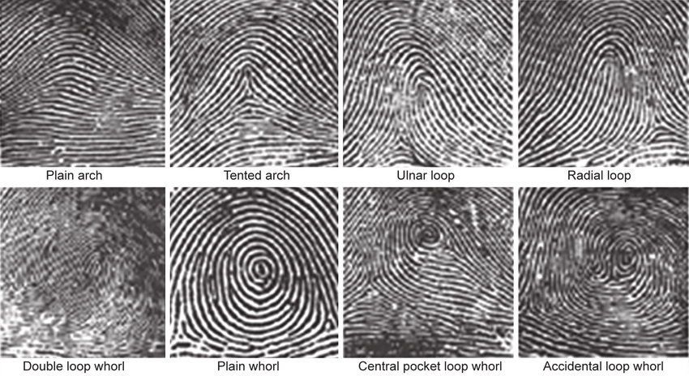

Slide 13
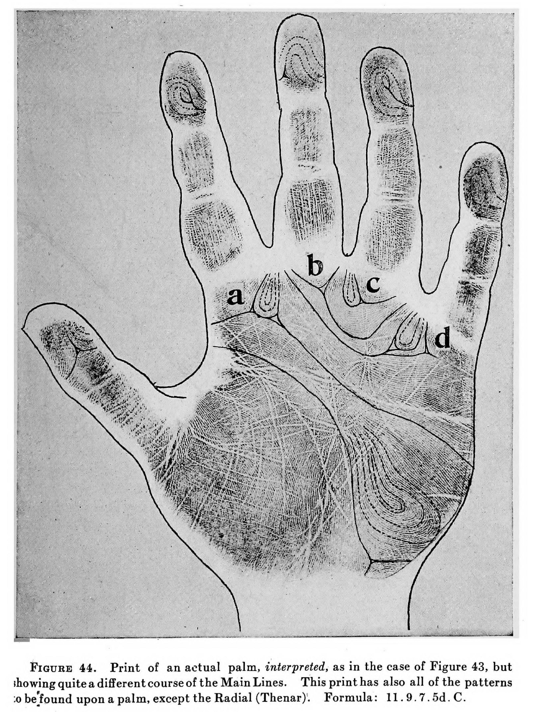

Slide 14
Identification and Authentication
Biometric authentication
Despite their security advantages, biometric systems also have considerable downsides.
First, they are expensive to install, requiring specialized hardware like fingerprint readers or eye scanners.
Second, they come with worrisome privacy concerns. Users may refuse for sharing their personal biometric data with a company or the government unless there is a good reason to do so.
Third, many users feel that retina scanner biometric authentication system may cause loss of their vision.
Notes:
Retinal scan technology is not without its drawbacks. According to a SANS Institute report, users of the technology have complained that the enrollment process -- where each person submits to a detailed retinal scan for the purpose of cataloging their identity -- is uncomfortable and intrusive. Users fear -- without scientific backup -- that the infrared light used in the scan damages their vision. Other optical recognition technology like iris scans, which take a grayscale photo of the iris, are considered less intrusive and are proven to be much faster.

Slide 15
Identification and Authentication
Single Sign-On (SSO)
Single sign-on (SSO) is a useful feature to consider when deciding between device authentication methods.
SSO enables a user to only enter their credentials once to gain access to multiple applications.
If the two sites are linked with SSO, the user will automatically have access to the cloud storage site after logging on to the email client.
SSO saves time and keeps users happy by avoiding frequently entering passwords.

Slide 16
Identification and Authentication
Single Sign-On (SSO)
It can also introduce security risks; an unauthorized user who gains access to one system can now penetrate others.
A related technology, single sign-off, logs users out of every application when they log out of a single one. This strengthen security by making certain that all open sessions are closed.

Slide 17
Identification and Authentication
CAPTCHAs
Hackers are using increasingly sophisticated automated programs to break into secure systems. CAPTCHAs are designed to neutralize this threat.
This authentication method is not focused on verifying a particular user; rather, it seeks to determine whether a user is in fact human.
The term CAPTCHA is an acronym for “completely automated public Turing test to tell computers and humans apart.”
The system displays a distorted image of letters and numbers to the user, asking them to type in what they see.
Notes:
Alan Mathison Turing was an English mathematician, computer scientist, logician, cryptanalyst, philosopher, and theoretical biologist.

Slide 18
Identification and Authentication
CAPTCHAs
Computers have a tough time dealing with these distortions, but humans can typically tell what they are.
Adding a CAPTCHA enhances network security by creating one more barrier to automated hacking systems.
However, they can cause some problems. Individuals with disabilities (such as blind people using auditory screen readers) may not be able to get past a CAPTCHA.
Even nondisabled users sometimes have trouble figuring them out, leading to frustration and delays.
Notes:
Distortions: Misrepresentation, twisting

